Slide 1

The Wonderful World of Marketing
Instructor: Bryan Venema

Slide 2




Marketing Pathway Courses
Store Operations is a second year course where students apply what they have learned by operating our DECA Store as a real business.
Advanced Business and Marketing is where students apply what they have learned by focusing on Leadership, Planning and DECA Activities.
Sports Marketing is where students learn about the Business side of sports. What happens behind the scenes to make sporting or entertainment events happen.
Business and Marketing is the first year course and provides the foundation for other courses.

Slide 3

Our History
This will be my 21st year at John R Rogers High School as the Marketing Instructor/DECA Advisor.
Our DECA Chapter has had 5 State Officers and 1 National President Candidate.
Spring of 2022 we had a team of 3 students place in the top 10 at the National Conference for the first time in school history.

Slide 4
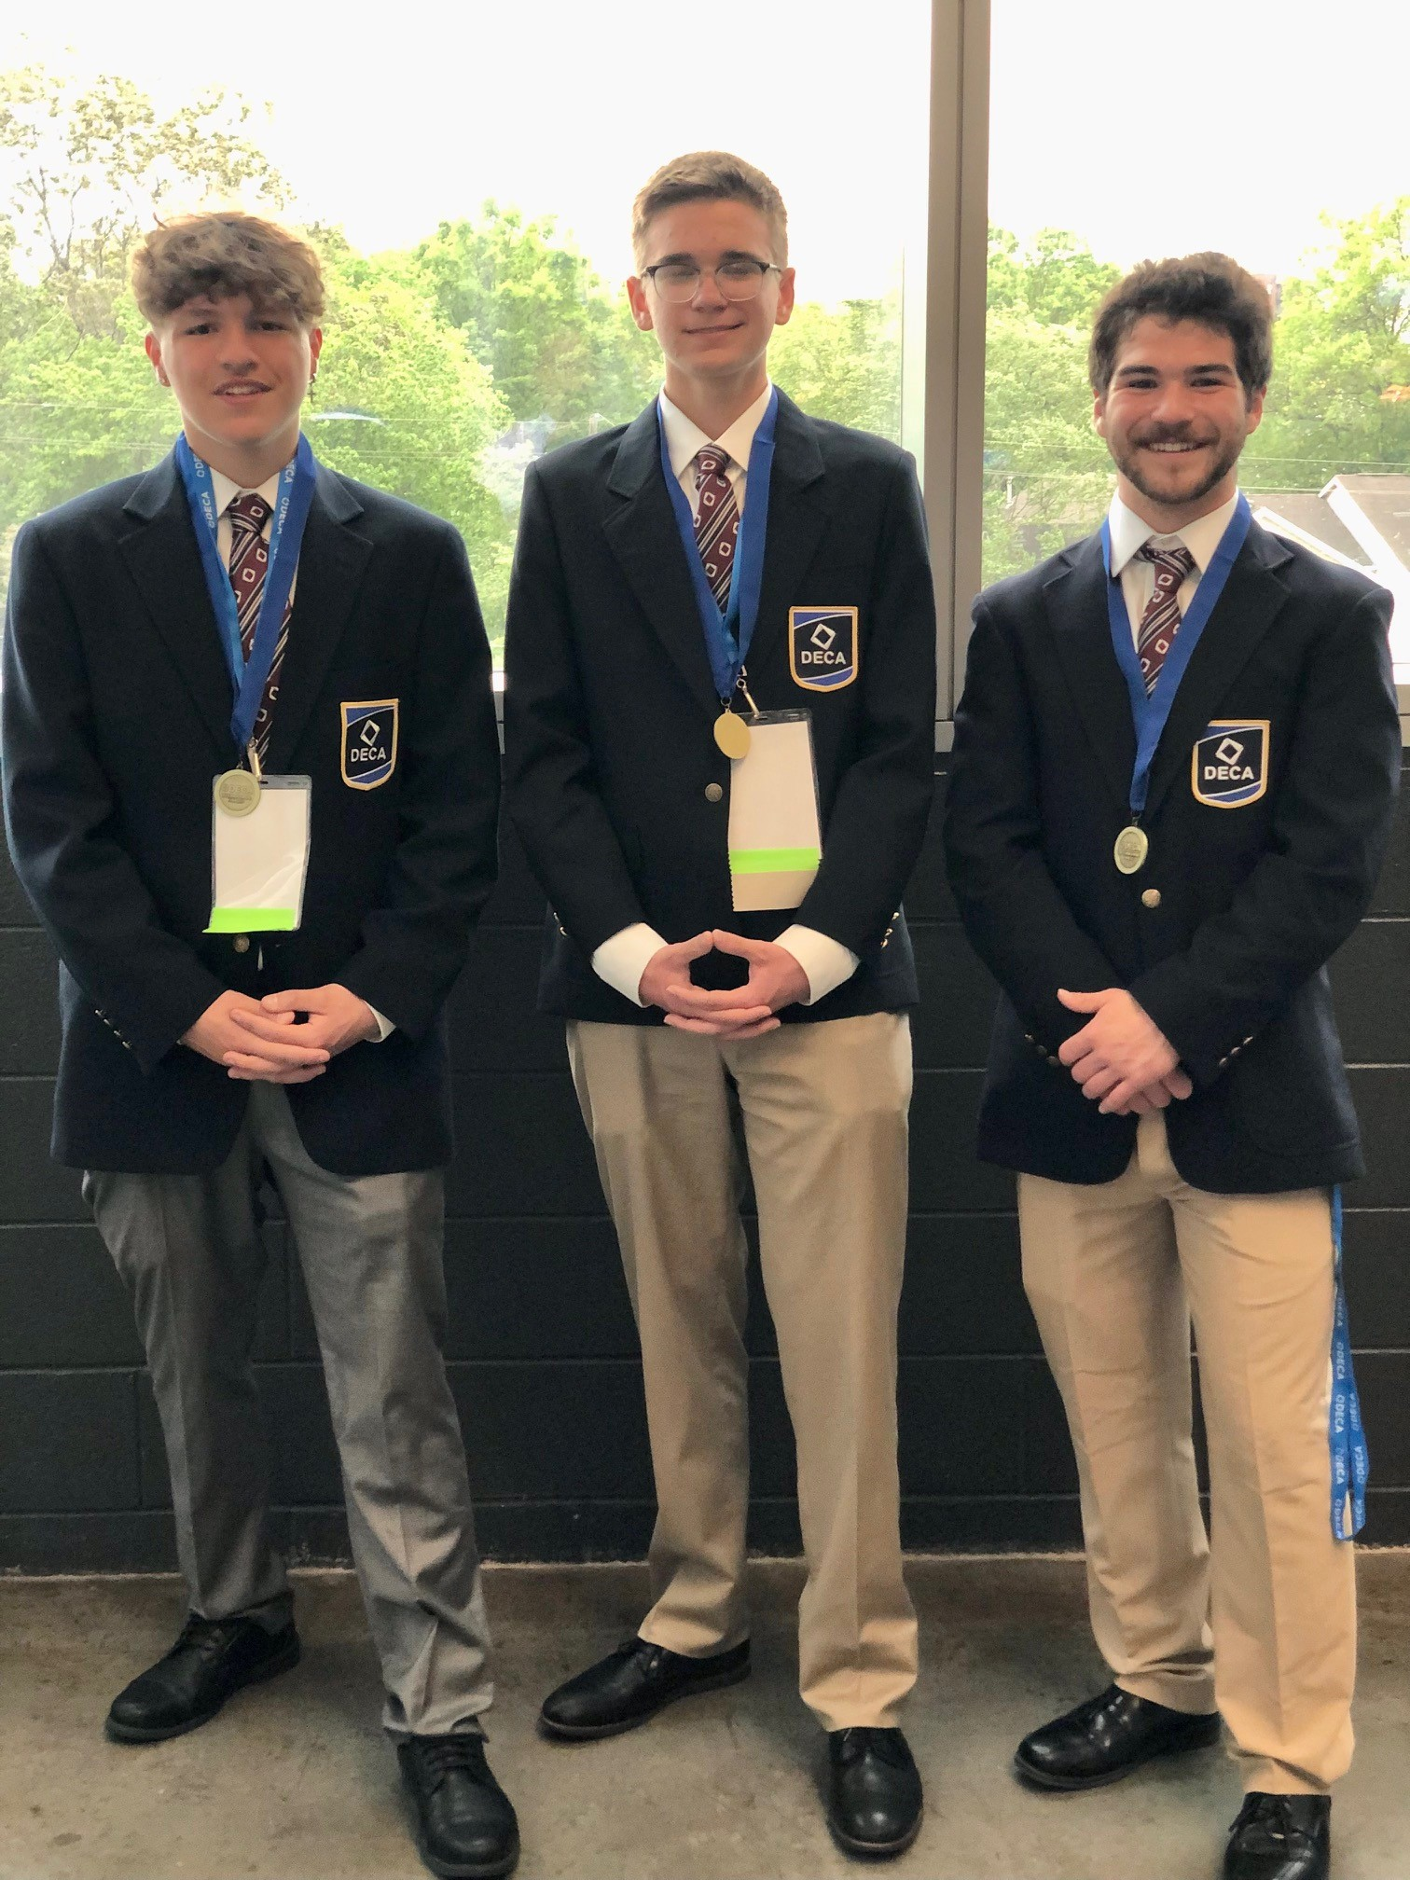
Two separate experiences, One program
DECA
DECA allows students to expand their learning beyond the classroom by participating in additional activities and conferences.
Conference opportunities for the year are: A Leadership conference in November, Area competition in December, Washington State competition in March and the National competition conference in April.
Courses:
Our classes teach students about the “Real Life” of the exciting world of Business and Marketing.
I expect students to hold daily conversations with you about what they are learning in class and how that information impacts their lives.

Slide 5

I can be reached at:
BryanV@spokaneschools.org
509-354-6632

